Slide 1
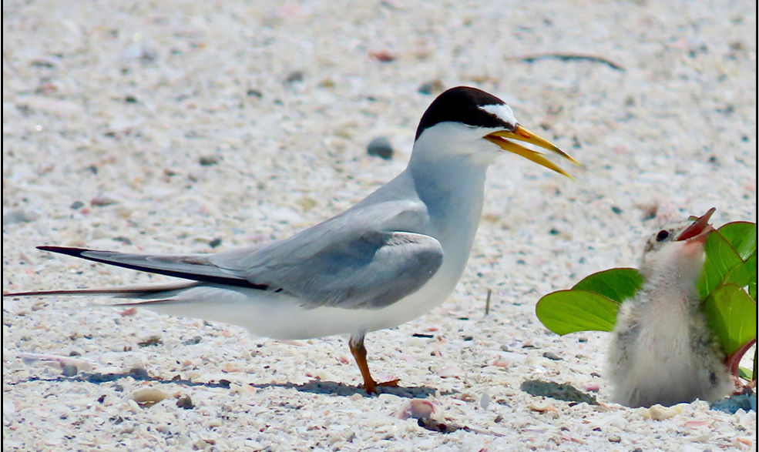
Fort Myers Beach Shorebird Nesting
Florida Fish and Wildlife Conservation Commission
February 2026
Photos by FWC unless otherwise noted

Slide 2
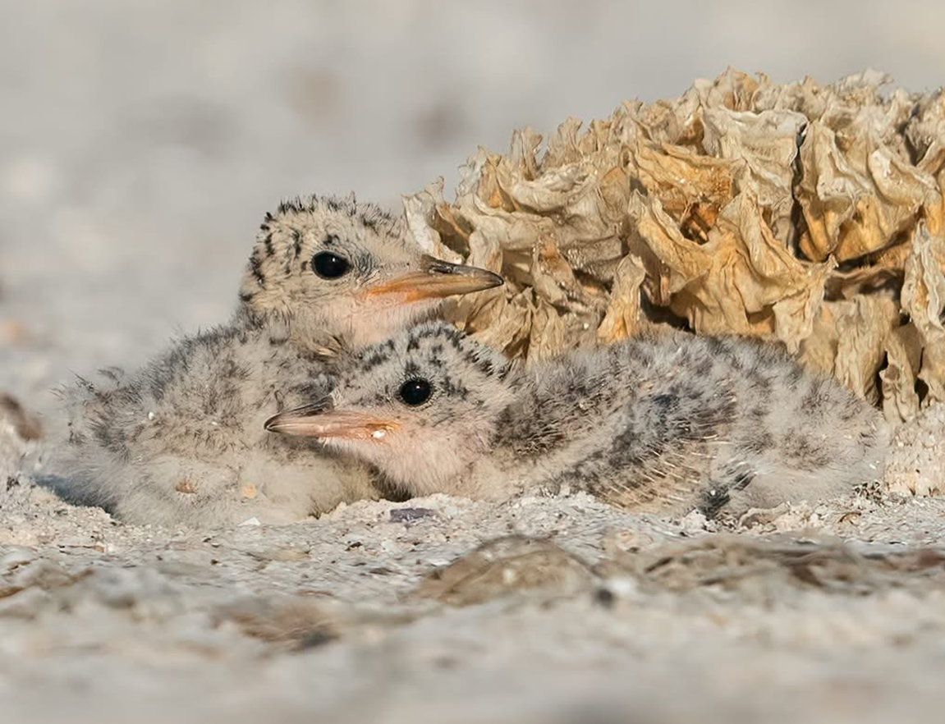
Imperiled Beach Nesting Birds on FMB
2025 Nesting Season Outcomes
Black Skimmer
Peak Adult Count: 849
Mean Adult Presence: 509
Peak Nest Count: 270
Estimated Chicks Fledged: 225
Least Tern
Peak Adult Count: 413
Mean Adult Presence: 195
Peak Nest Count: 250
Estimated Chicks Fledged: 221
Snowy Plover
Total Nests: 3
Chicks Fledged: 8
Renest Attempts: 0
Wilson’s Plover*
Total Nests: 8
Chicks Fledged: 10
Renesting Attempts: 2
American Oystercatcher
Total Nests: 0
Adults still present throughout the year
Photo by Jamey Binneveld
* Wilson’s Plover is a Candidate Species to be listed as State-Threatened
Notes:
Observations: (Just added the observations from Bre’s end of season report- this can be trimmed down to highlight talking points)
Black Skimmer: Although overall black skimmer colony numbers declined locally, this trend was not unexpected due to active colonies documented at Lovers Key State Park, the Sanibel Causeway, and more. These sites likely contributed to a redistribution of nesting effort across the region. Despite shifts in colonial nesting locations, productivity at Fort Myers Beach increased compared to 2024. At peak extent, the colony occupied approximately four acres and supported a high density of nests and chicks. Nesting occurred just outside of a vegetated area that chicks utilized for shading during the heat of the day. There were no sandspur related illness or injuries documented this year.
Least tern colony numbers remained comparable to 2024, which was somewhat unexpected given the establishment or reestablishment of successful colonies at Big Hickory Island, the Sanibel Causeway, Wellen Park and more. Although the peak nest count was slightly lower in 2025, overall productivity was substantially higher. Improved productivity in 2025 was likely influenced by more stable environmental conditions. Unlike 2024, when multiple overwash events resulted in repeated renesting attempts, 2025 conditions produced fewer renests and improved overall nest success. At peak extent, the least tern colony occupied approximately 5.5 acres of soft sandy open beach. Portions of the colony were located within a densely vegetated area later in the nesting season, and chicks routinely used the vegetation for shade during peak daytime heat.
Snowy Plover: Despite the relatively low number of nests, fledging success was notable, resulting in strong productivity relative to nesting efforts. Similar to last year, most nesting occurred on the wide, open sandy habitat of the 6000-block beach, where chicks were successfully raised and fledged before later being observed at the far south end of Fort Myers Beach near the lagoon in front of Carlos Pointe Condominiums. Snowy plovers were also frequently observed foraging in beach groomer drag marks, using these disturbed areas to locate insects. Both the 6000-block beach and the 8000-block lagoon provided highly productive foraging habitat for both adult and juvenile birds.
During the 2025 season, more favorable weather conditions - including temperatures, consistent wind, and the absence of major overwash events - likely contributed to improved nesting success. Many adults were frequently observed off their nests during the hottest parts of the day, likely as a behavioral response to daytime heat.
WIPL: Two renesting attempts were confirmed in 2025, in contrast to 2024 when no renests were documented, although several were suspected. While the total number of nests and fledged chicks remained similar between years, documented renesting contributed to a modest increase in overall productivity.
Seven of the eight nesting attempts occurred within the Critical Wildlife Area, with one successful nest located within the colonial nesting site on Carlos Beach. Many nesting attempts received substantially increased oversight in 2025 compared to 2024 due to the Fort Myers Beach nourishment project, which required daily on-site presence of IBNB-permitted monitors.
During the 2025 season, more favorable weather conditions - including temperatures, consistent wind, and the absence of major overwash events - likely contributed to improved nesting success. Many adults were frequently observed off their nests during the hottest parts of the day, likely as a behavioral response to daytime heat.

Slide 3
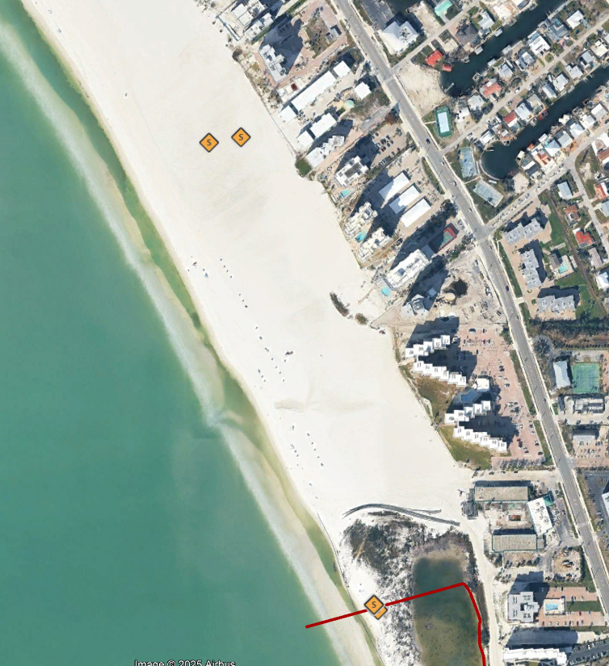
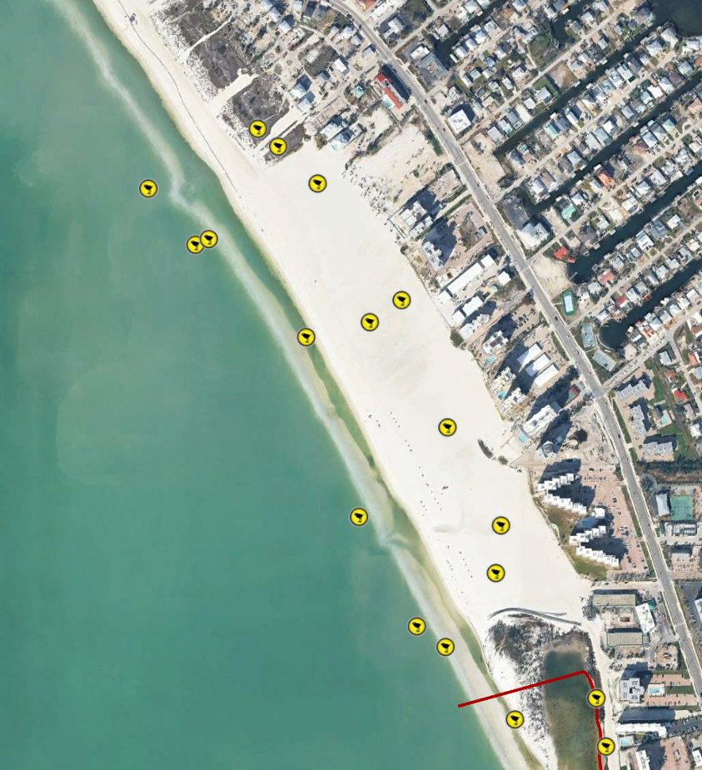
Sunset Beach
Notes:
On 6000 block beach - regular SNPL nesting and occasionally WIPL foraging. Large groups of birds use the 6000 beach area for resting and foraging including LETE, BLSK, ROSP, and other various species. When there is heavy rain or high tides and tidal ponds are formed, hundreds of birds will congregate.

Slide 4
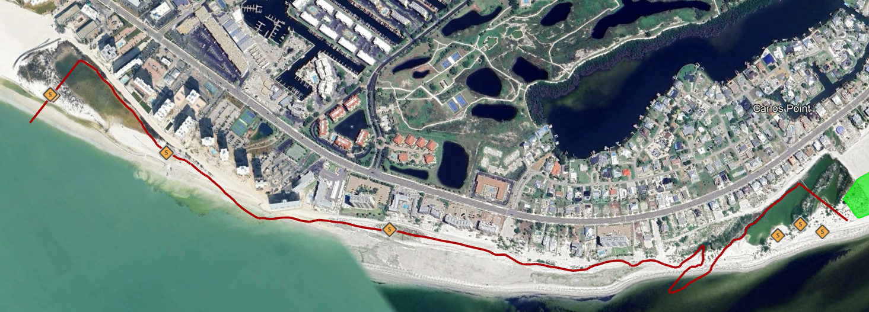
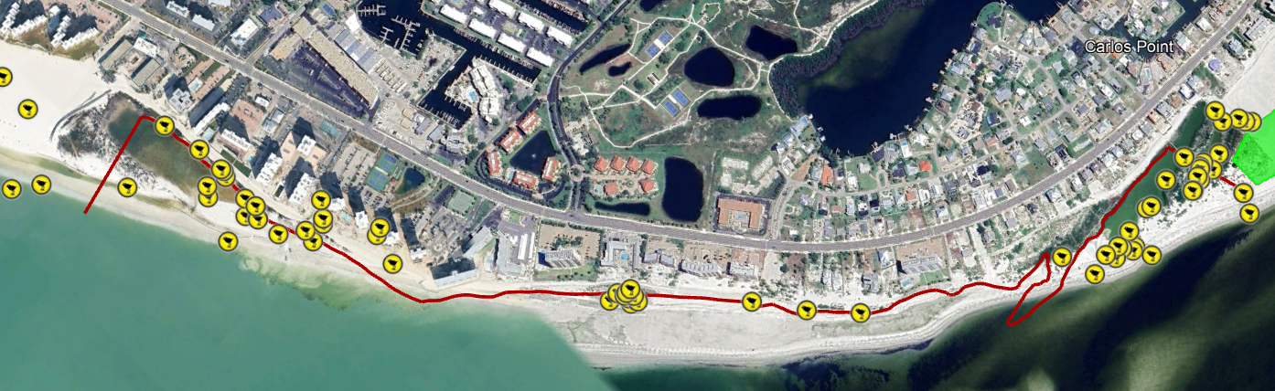
The Little Estero Island CWA
Notes:
WIPL, SNPL, LETE, KILL nest within CWA boundaries. No AMOY nesting during 2024-2025 but historically they have nested just north of Leonardo Arms. Most nesting occurs toward the northern end lagoon, or the very southern CWA lagoon around Ed Rood's boardwalk. Other species that nest in the dry vegetation/open beach: CONI, CGDO

Slide 5
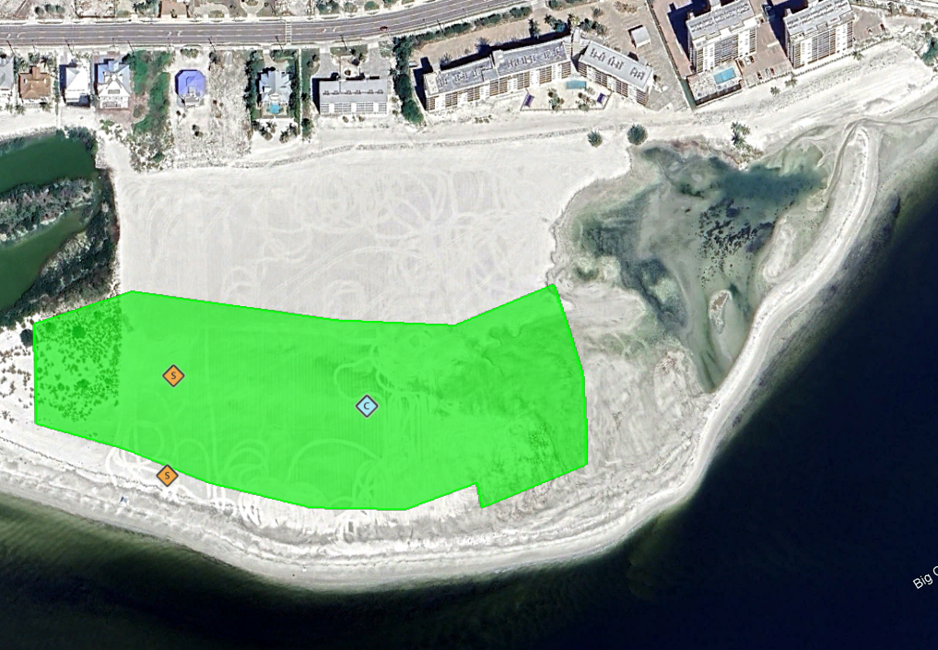
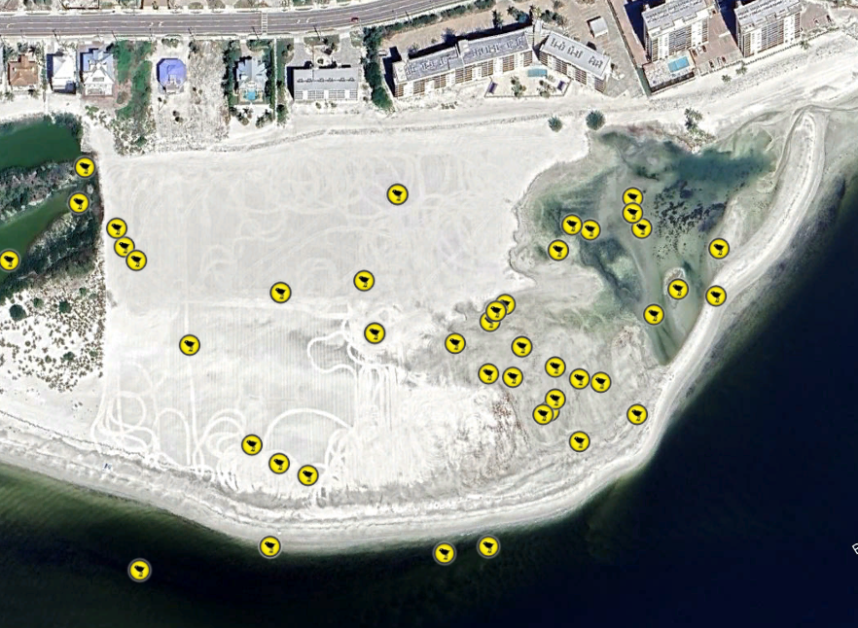
Carlos Beach

Slide 6
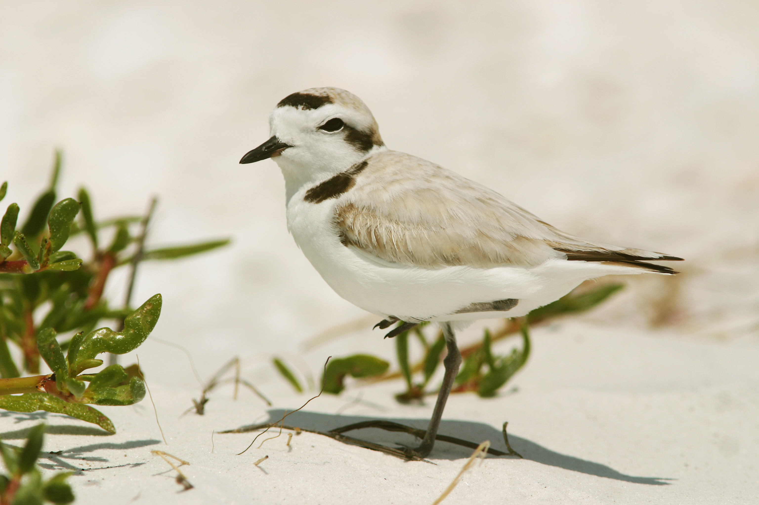
Conservation Milestones
2025 Nesting Season Outcomes
Improved nesting habitat
Herbicide treatments to reduce sandspurs
Limited over wash events
Increased productivity
Stakeholder engagement
Pre-season engagement
Within-season updates on management plans and nesting status
Adaptive management in response to nesting
Adjusted size of posted area
Hand removal of vegetation to support flightless chick habitat
Notes:
Due in part to our positive outcomes in this community, the Florida Shorebird Program is on track to reach our goal of a 10% increase in the population levels of five focal species by 2029. I want to strongly emphasize that Fort Myers Beach plays a major role is attaining that milestone: this site is among only a few in the entire state where all five of these imperiled species are found nesting on one beach.

Slide 7
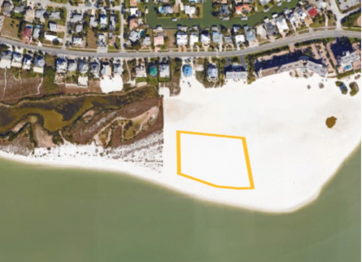
Proposed Management Plans
2025 Management
Posted an agreed upon herbicide management area with blank wooden posts prior to treatment
Treated only within posted area
Pre-posted area was closed off with string, flagging and signs once nesting was initiated
Limited growth of sandspurs throughout the nesting season within treated area
Pre-posted vegetation management area for the 2025 nesting season.
Pre-posted vegetation management area for the 2025 nesting season

Slide 8
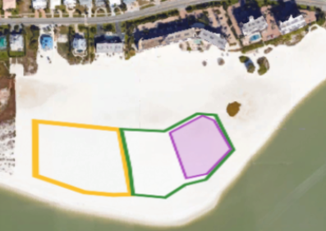
Proposed Management Plans
2026 Proposed Management
Pre-season management
Discuss pre-posting adjustment based on 2025 patterns of nesting
Conduct targeted herbicide treatment in pre-posted area
Adaptive Management throughout nesting
Close off posted area once nesting initiates
Adjust posting size as colony establishes
Decrease posting later in nesting season if the colony size diminishes
2025 Colony footprint shown in yellow & green polygon. Yellow polygon was pre-posted and treated. Colony posting expanded to the green polygon. Purple polygon shows are where hand-pulled vegetation removal during 2025 nesting season.

Slide 9
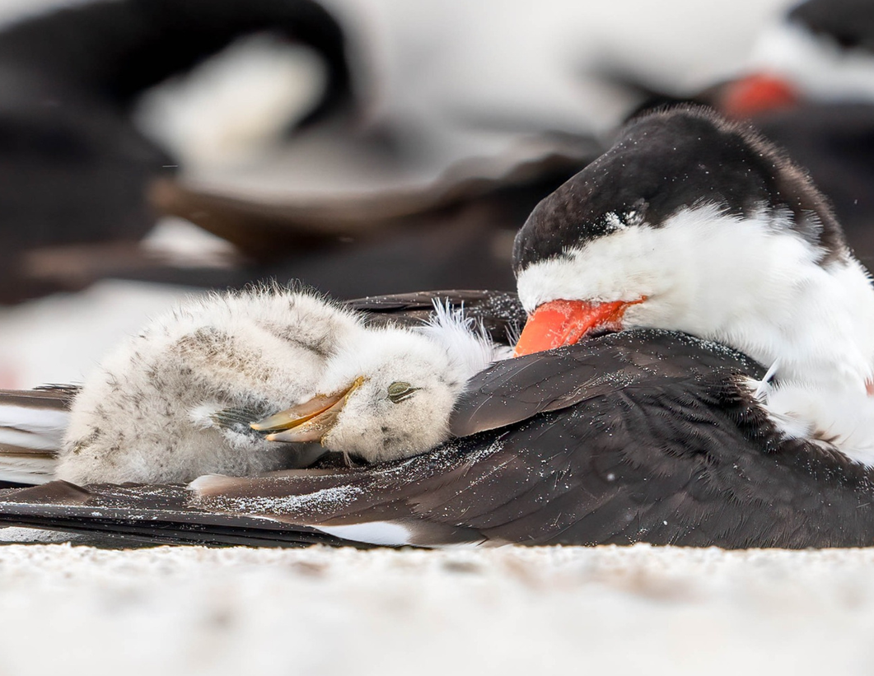
2026 Proposed Management Plan
Upcoming-
Beachfront property stakeholder engagement pre-season correspondence by email
Management Plan Q&A with FWC by virtual meeting
Continued engagement and communication with stakeholders throughout nesting season by in person interactions
Photo by Jamey Binneveld

Slide 10
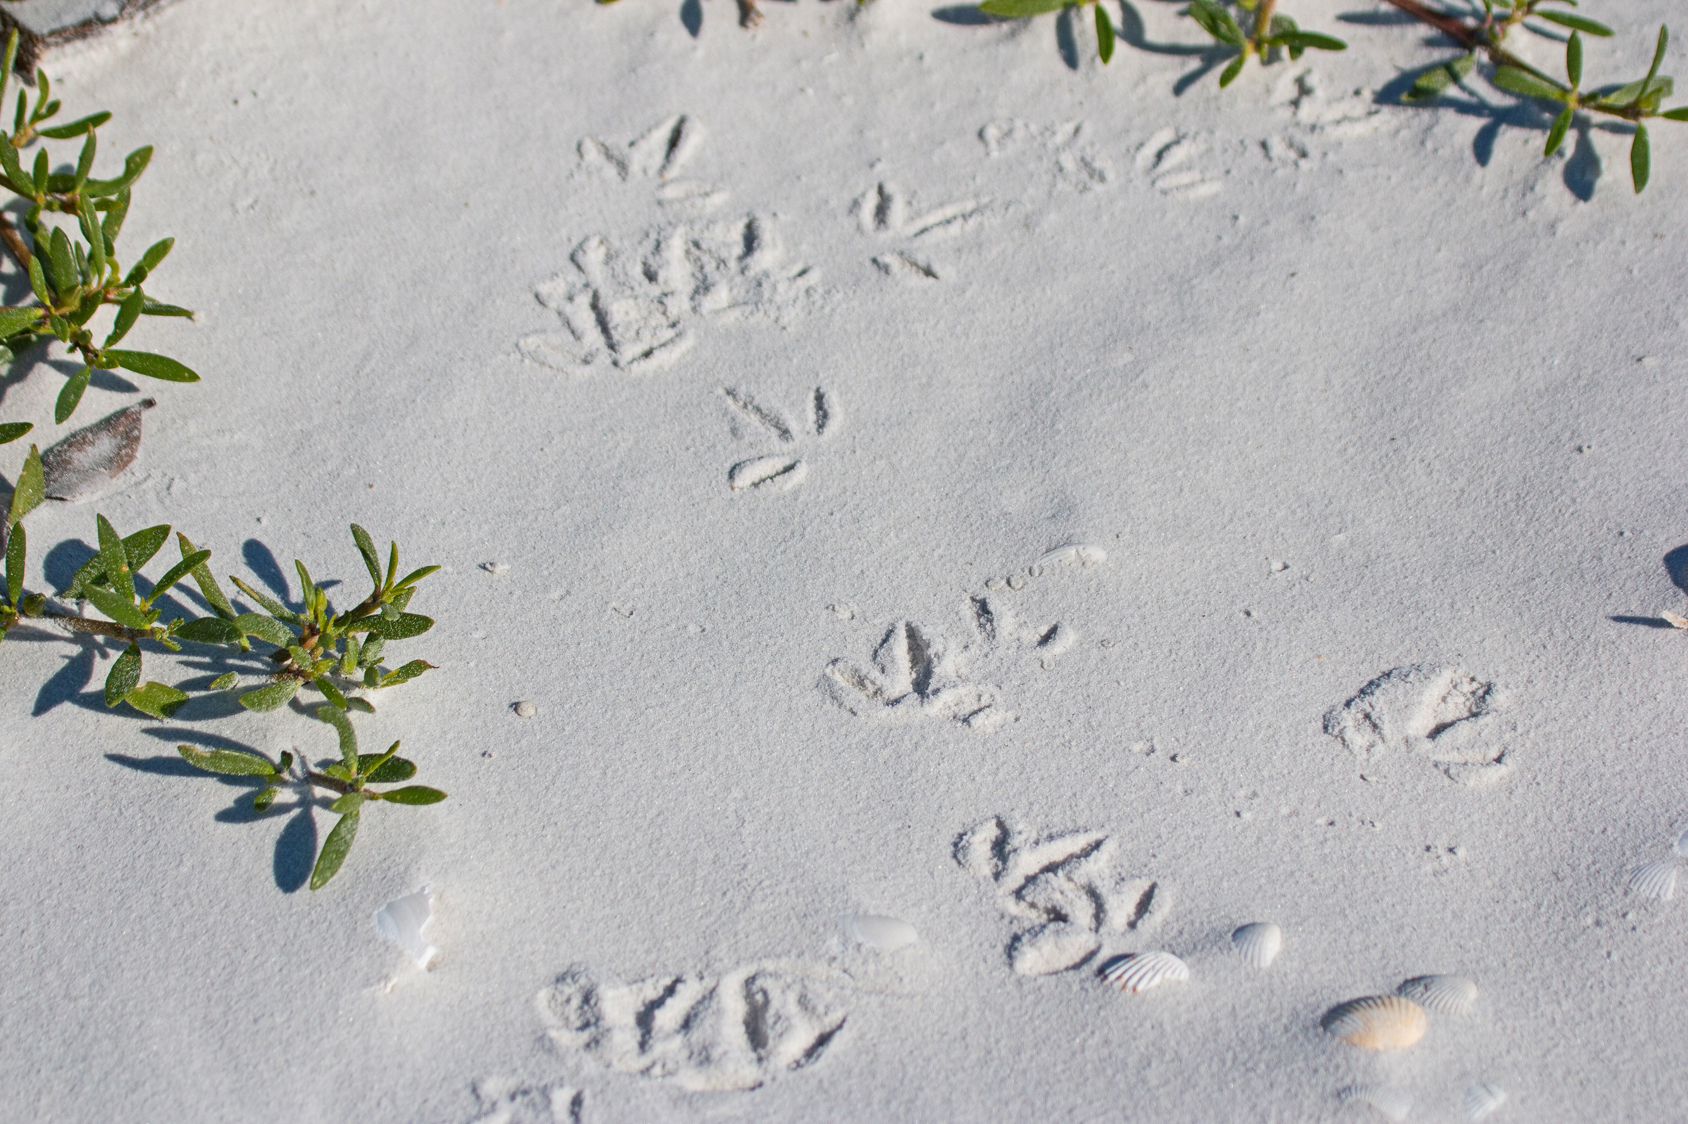
Thank you!
Contact us:
Monica McKenzie
Southwest Shorebird Biologist
Monica.McKenzie@myfwc.com
Becky Schneider
Southwest Regional Biologist
Rebecca.Schneider@myfwc.com

