Slide 1
Town Lighting Review Policy
Lighting Standards & Sea Turtle Conservation

Slide 2
Town Codes
LIGHTING STANDARDS
Sec. 34-1831
Purpose:
curtail and reverse the degradation of the night-time visual environment
minimize light pollution, glare, and light trespass
conserve energy and resources
maintain night-time safety, utility, security and productivity
Applicability
All new luminaires, regardless of whether a development order is required, must comply with the provisions and standards of this division

Slide 3
Town Codes
Sea Turtle Conservation
Sec. Sec. 32-101 to 102
Purpose:
protect nesting and hatchling sea turtles on the beaches in the Town
ensure that nesting habitat is not degraded by artificial light
Applicability
all properties within the town that may produce artificial light directly, indirectly, or cumulatively visible from any portion of the beach, regardless of whether those properties are beachfront properties
all buildings and related infrastructure, including landscaping, as well as all other activities that may adversely impact sea turtles

Slide 4
Town Codes
When is a Lighting Review Required?
Prior to issuance of development order or building permit for new structures, new construction, and improvements to existing structures for
All structures waterward of 1991 CCCL
All multi-family and commercial structures landward of 1991 CCCL

Slide 5
Town Codes
When is a Lighting Review Required?
Prior to issuance of development order or building permit for new structures, new construction, and improvements to existing structures for
All structures waterward of 1991 CCCL
All multi-family and commercial structures landward of 1991 CCCL

Slide 6
What is a Lighting Review Reviewing?
Light Standards (Sec. 34-1833)
Illuminance = Brightness
Photometric Data (Commercial & Multifamily (3+) Only)
Must meet minimum and maximum standards
Measured in Lumens, Footcandles, Watts
Lamp Standards = Bulb/LED Type & Color
Must be in harmony with the adjacent community
Consistent with the task and setting
Should not create a mix of colors

Slide 7
What is a Lighting Review Reviewing?
Light Standards (Sec. 34-1833)
Luminaire Standards = Light Fixtures
Fully shielded, full cutoff recessed bulbs and flat lenses are the only permitted fixtures for outdoor lighting
Exceptions
20 watt bulbs unshielded
60 watt bulbs shielded
Motion Detector Lights (must be properly configured)
60 Watt Flood Lights (must be properly configured)
All externally illuminated signs (shielded fixtures mounted at the top of the sign, aimed downward)
Fixtures used to accent architectural features and landscaping

Slide 8
What is a Lighting Review Reviewing?
Light Standards (Sec. 34-1833)
Mounting Standards = Light Poles
Placement on Interior of Site Preferred
15 Foot Mounting Height
Except within 50 feet of Residentially Zoned = 12 Foot MH
Exception for existing poles
Building Mounted
Must be attached to walls
MH may not exceed lowest point of roof or parapet
Canopy Lighting
Must be fully shielded full cutoff fixtures

Slide 9
What is a Lighting Review Reviewing?
Light Standards (Sec. 34-1833)
When specific standards are not addressed in these sources, the standards of the Illuminating Engineering Society of North America (IESNA) will apply
In addition to the standards and criteria in this section, there are standards for artificial lighting near sea turtle nesting habitat
= Sea Turtle Conservation Code

Slide 10
What is a Lighting Review Reviewing?
Sea Turtle Conservation Code (Sec. 32-105)
All artificial lighting affixed to the exterior of new permanent structures, construction or additions shall be:
long wavelength
downward directed
full cutoff
fully shielded (exception for lights on landward side of building)
mounted as close to the ground as possible
Must achieve required foot candles
Florida Building Code
Department of Health

Slide 11
Why do we need lighting reviews?
Human Health and Safety
Not too Bright, Not too Dark
Not subjective - Use Illuminance Guidelines in Code
Sea Turtle Conservation
Increase hatchling survival rates for species recovery
Sea Turtles are natural light detectors

Slide 12
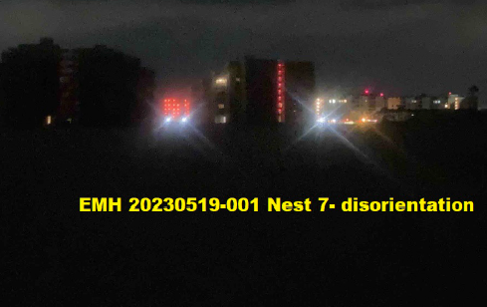
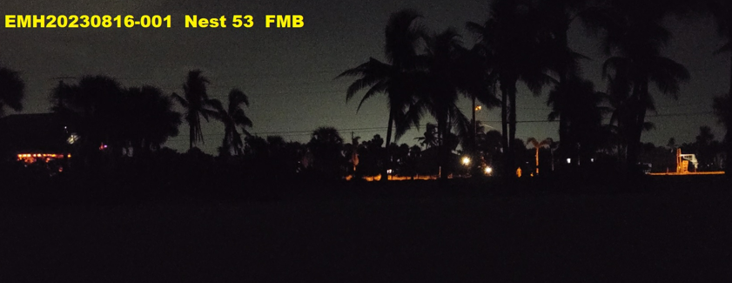
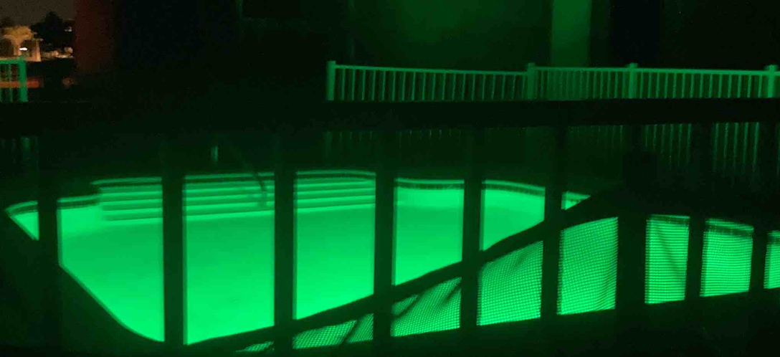
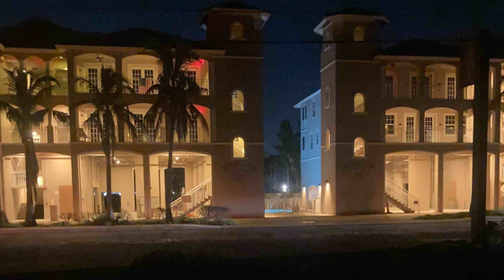
What happens when we do not review lighting?

Slide 13
Existing Lights Reviewed?
Requested to be included in Lighting Plan submittal
Not always in scope of project to be review-able
Just replacing lights that were here before…
What does Code Say?
Sec. 34-1834 (c) Existing light fixtures must be brought into compliance with this code by January 1, 2010.
Any fixtures replaced after the date of the adoption of this code must be replaced with fixtures that comply with the standards established herein.
Illuminance levels specified in this code apply to all outdoor lighting.
Sec. 32-106. Existing artificial lighting affixed to the exterior of permanent structures shall not be directly, indirectly, or cumulatively visible from any portion of the beach during sea turtle nesting season.

Slide 14
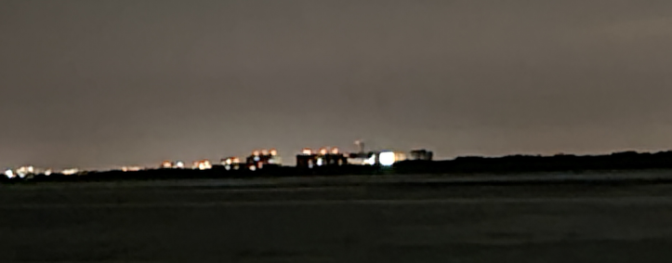
What is TFMB Policy?
Directly visible from the Beach
Long wavelength light source
In downward directed fixture
Light source is shielded from the beach
Includes structures that are NOT beach front
Why?
Hurricane Ian removed vegetation and structures that previously shielded light
View corridors must be assessed 270 degrees from source
Estero Island is S-shaped
Lights can be visible from multiple angles
Can be visible from other beaches!

Slide 15
What is TFMB Policy?
Indirectly visible from the Beach
Long wavelength light source
Not required to be shielded provided light is not directly, indirectly, or cumulatively visible from any portion of the beach
Must still comply with Light Standards Code

Slide 16
What is TFMB Policy?
Cumulatively visible from the Beach
What does that even mean???
Sec. 32-103 Cumulatively visible means light from numerous artificial light sources on a single property that as a group are directly or indirectly visible to an observer standing anywhere on the beach.
How do we assess this?
Where does indirectly visible end and cumulatively visible begin?
In other words, where do we stop requiring long wavelength lights and only require Lighting Standards Code to apply?

Slide 17
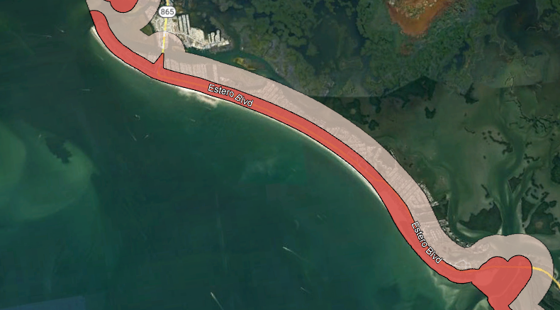
What is TFMB Policy?
Options
Require Long Wavelength Light Everywhere?
Use 1991 CCCL as delineation?
Use FWC Guidance?

Slide 18
What is TFMB Policy?
Created by the FWC's Imperiled Species Management Section.
Buffers are for planning purposes only and includes the minimum recommended area where specific lighting should occur.
Wildlife-Sensitive Conventional Lighting (RED LAYER)
minimum recommended area where lighting should be designed to meet the criteria for Wildlife-Sensitive Conventional Lighting
Dark Sky (GREY LAYER)
minimum recommended area where lighting should be designed to minimize glare and sky glow by using downward directed, full cut off fixtures.

Slide 19
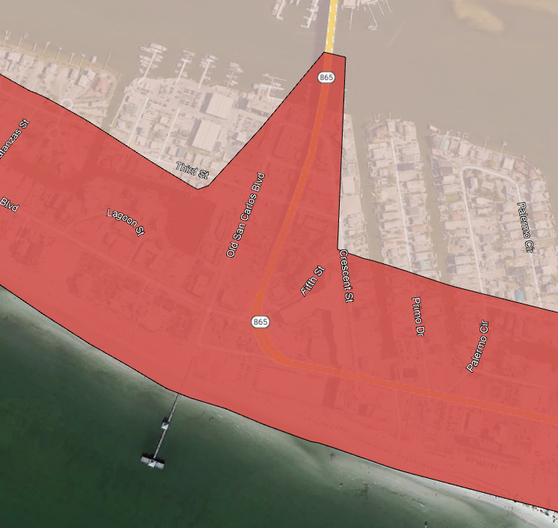
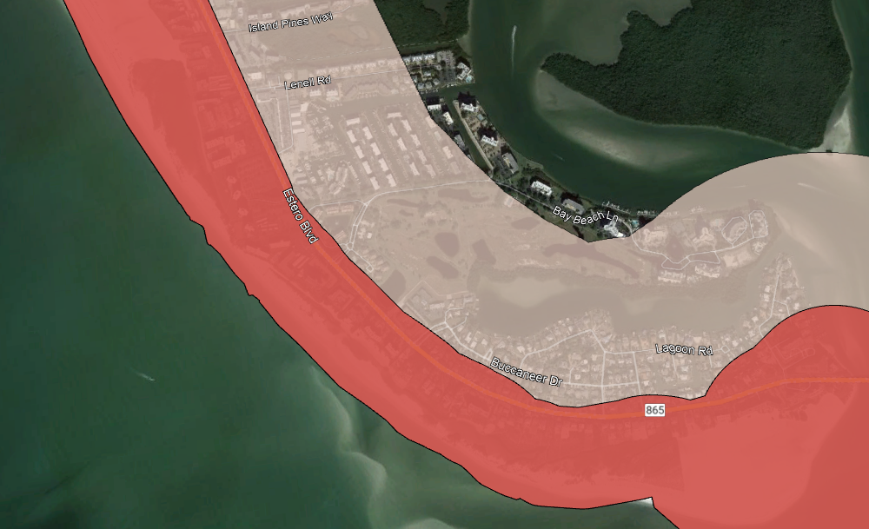
What is TFMB Policy?

